Slide 1
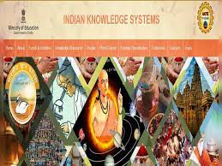
Introduction to Indian Knowledge System (IKS)

Slide 2
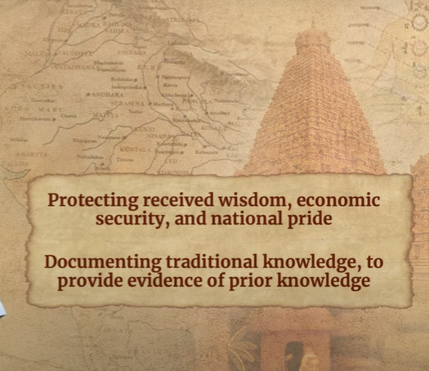
Introduction to Course

Slide 3


Introduction to Course

Slide 4
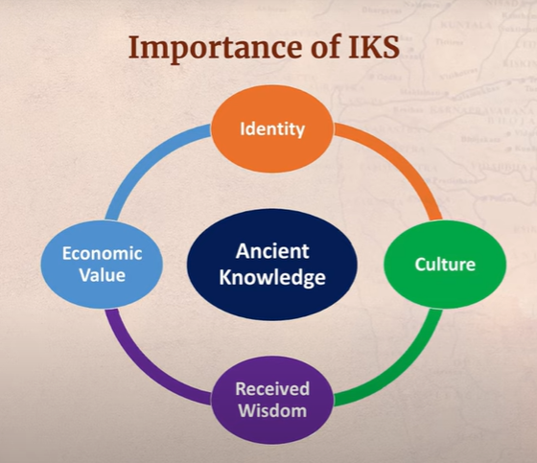
Introduction to Course

Slide 5
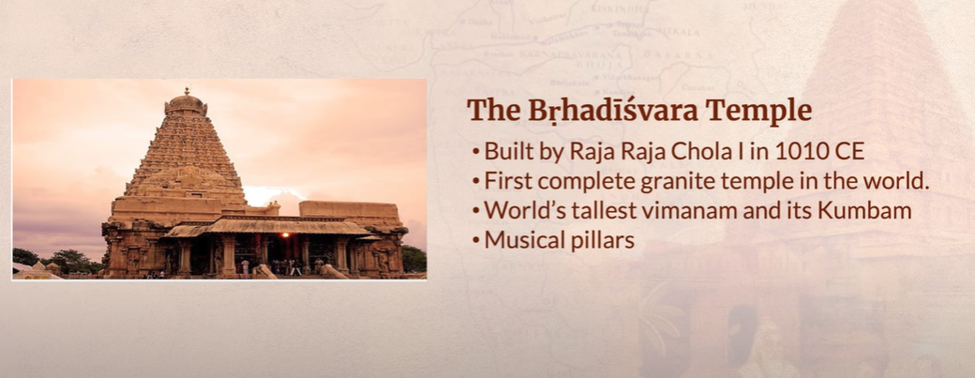
Brhadisvara Temple, Tamil Nadu

Slide 6
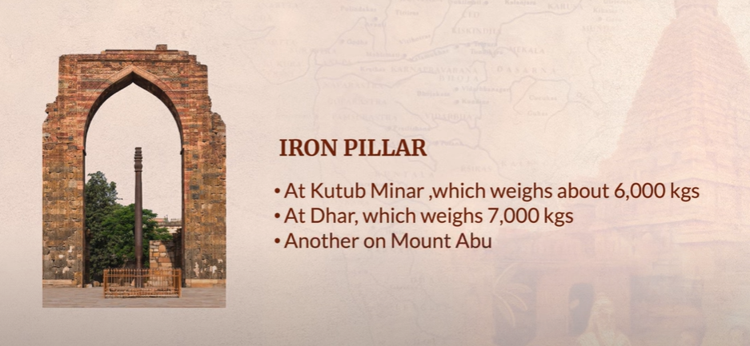
Iron Gates

Slide 7
Indian Knowledge System (IKS) Bharatavarsha—A Land of Rare Natural Endowments

Slide 8
Content
1.1 The idea of Bharatavarsha, A Land of Rare Natural Endowments, The Vedic Corpus. The Itihasas— Ramayana and Mahabharata, and their important regional versions.
1.2 The Puranas & Upnishads, Earlier Buddhist writings- Abhidhamma Pitaka,Vinaya Pitaka, Sutta Pitaka
1.3 Important Indian ancient Sanskrit literary work-Vikramovasiyam and Mricchakatika.
1.4 Sangham Literature (Art & Culture)

Slide 9
About IKS
Indian knowledge spans a wide range of disciplines, including philosophy, spirituality, physics, mathematics, medicine, and literature. And it is still thriving and developing
Modern knowledge and its ancient wisdom are being combined to produce new improvements across many sectors.
Indian Knowledge System (IKS) is an innovative cell under Ministry of Education (MoE) at AICTE, New Delhi.
It is established to promote interdisciplinary research on all aspects of IKS, preserve and disseminate IKS for further research and societal applications.
It will actively engage for spreading the rich heritage of our country and traditional knowledge in the field of Arts and literature, Agriculture, Basic Sciences, Engineering & Technology, Architecture, Management, Economics, etc.

Slide 10
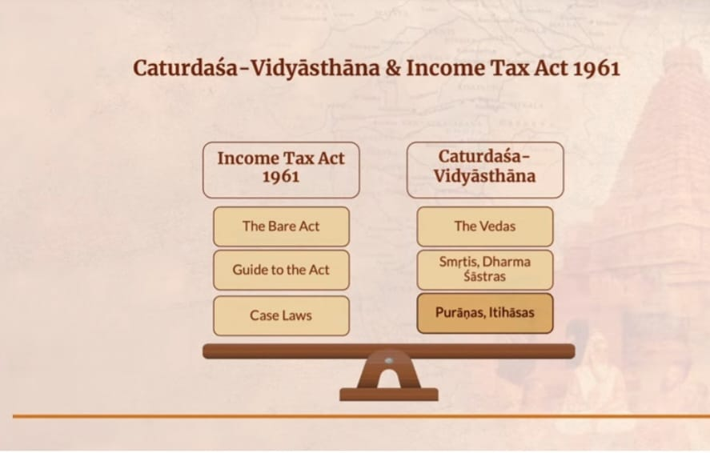
Why IKS???

Slide 11
Lecture 01- The idea of Bharatavarsha, A Land of Rare Natural Endowments
Bharatvarsha is a translation of the Vedic word Bharata, which signifies Bharata's homeland
Later, the same geographic area was referred to as Hindustan, and during the British era, this region became known as India.
Bharatvarsha is frequently portrayed as a sacred land connected to numerous deities, sages, and key events in Hindu mythology and religious writings including the Mahabharata and Ramayana. For millions of people, it has enormous spiritual and cultural significance.
Bharatvarsha has a long history of blending various languages, faiths, and cultural customs. Major religions including Hinduism, Buddhism, Jainism, and Sikhism have called it home. Islam, Christianity, and other religions have all arrived in the country and had an impact, creating a diverse tapestry of customs and beliefs.

Slide 12
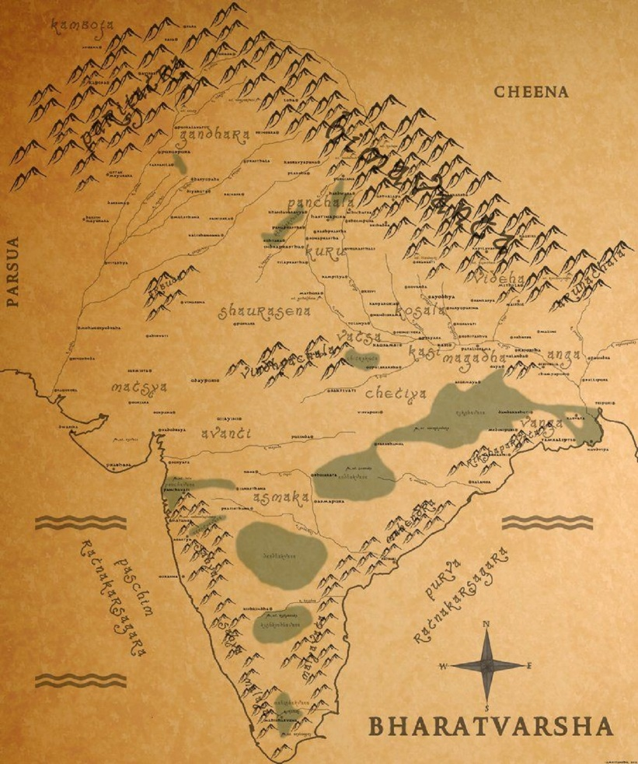
Bharatvarsha is still used to symbolize India's diverse and vibrant nation, which is distinguished by its unity in variety. It comprises a wide range of languages, customs, religious beliefs, and cultural norms, adding to the intricate tapestry of Indian civilization.

Slide 13
A Land of Rare Natural Endowments
India, or Bharatvarsha, is a country with exceptional natural resources.
India is one of the world's 17 megadiverse nations and is home to a wide range of plant and animal species. India's wildlife is fascinating and diverse, including the majestic Bengal Tiger, the elegant Indian peacock, the critically endangered Indian rhinoceros, and the elusive snow leopard.
A number of biosphere reserves, national parks, and sanctuaries exist throughout the nation that are devoted to protecting its abundant biodiversity.

Slide 14
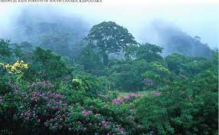
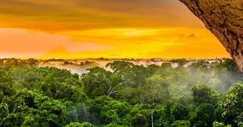
Forests: India has a significant forest cover that includes a variety of forest types, including mangrove forests, deciduous forests, and tropical rainforests.

Slide 15

2.Rivers & Waterbodies: India has a vast network of rivers, including well-known ones like the Ganges, Brahmaputra, and Yamuna, which are essential for irrigation, the production of hydroelectric power, and transportation. The nation is also renowned for its beautiful lakes, including as Vembanad Lake in Kerala, Chilika Lake in Odisha, and Dal Lake in Kashmir.

Slide 16
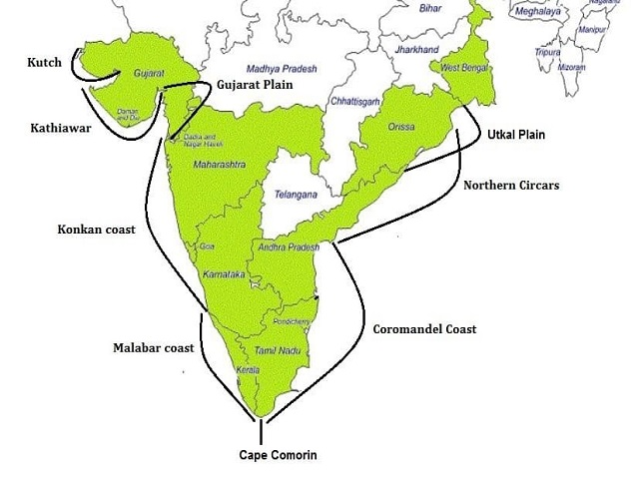
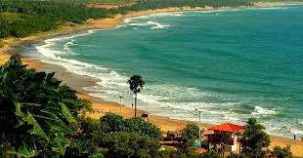
3. Coastal Areas: India has a long, 7,500-kilometer coastline that is home to beautiful beaches, plains along the shore, and mangrove forests. The spectacular marine biodiversity found in the Gulf of Mannar, the Andaman and Nicobar Islands, and the Lakshadweep Islands is well known.

Slide 17
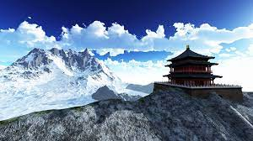
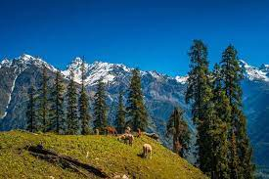
4. Himalayan Range: The Himalayas offer breathtaking scenery, snow-capped peaks, and verdant valleys. They also provide chances for adventure tourism, trekking, and mountaineering, as well as acting as a significant watershed for significant rivers.

Slide 18
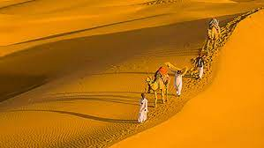
5. Deserts and Arid Regions: One of the greatest desert areas in the world is India's Thar Desert, which is situated in the country's northwest. It showcases a unique ecosystem adapted to harsh desert conditions. The desert also displays a rich cultural tapestry thanks to its nomadic communities, festivals, and folk traditions.

Slide 19
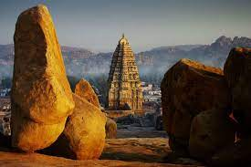
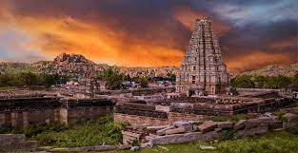
6. Natural Wonders: The Western Ghats, the Nilgiri Mountains, the Dhauladhar Range, and the rock formations of Hampi are just a few of the breathtaking natural wonders that can be found in India.
Conclusion: Bharatvarsha's rich natural history adds to its appeal as a travel destination for adventurers, nature lovers, and those who like wildlife from all over the world.

Slide 20
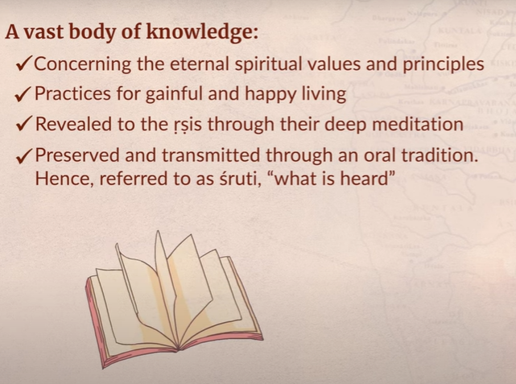
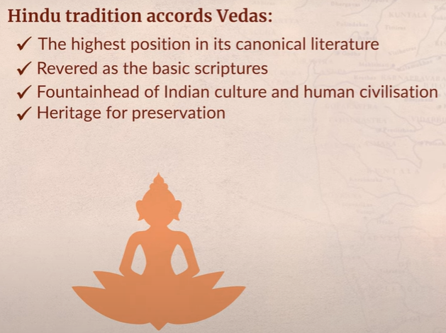
The Vedas: Meaning

Slide 21
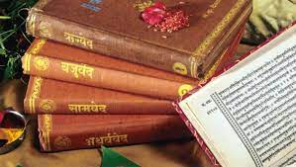
The Vedic Corpus: The Itihasas— Ramayana and Mahabharata, and their important regional versions
The Vedas are the lengthy collections of sacred writing that go back to ancient India and are written in Vedic Sanskrit.
It comprises the oldest body of Sanskrit literature as well as the oldest Hindu scriptures.
According to legend, the Vedas were verbally transmitted from one generation to the next. As a result, they are often referred to as Shruti.
The four Vedas—Rig Veda, Sama Veda, Yajur Veda, and Atharva Veda—make up the body of the Vedic literature. Samhita refers to the mantra text of each of the Vedas.

Slide 22
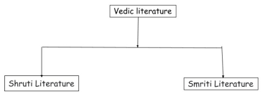
Shruti Literature- The name "Shruti Literature" refers to the sacred scriptures, which include the Vedas, Brahmanas, Aranyakas, and Upanishads, and the word "Shruti" from the meaning means "to hear." Shruti Literature is regarded timeless since it contains revelation and undeniable truth.
Smriti Literature – In contrast, the word "Smiriti" literally means "to be remembered," is supplemental, and is subject to change. The Smriti Literature, which includes the Vedanga, Shad darsana, Puranas, Itihasa, Upveda, Tantras, Agamas, and Upangas, is the entirety of post-Vedic Classical Sanskrit literature.

Slide 23
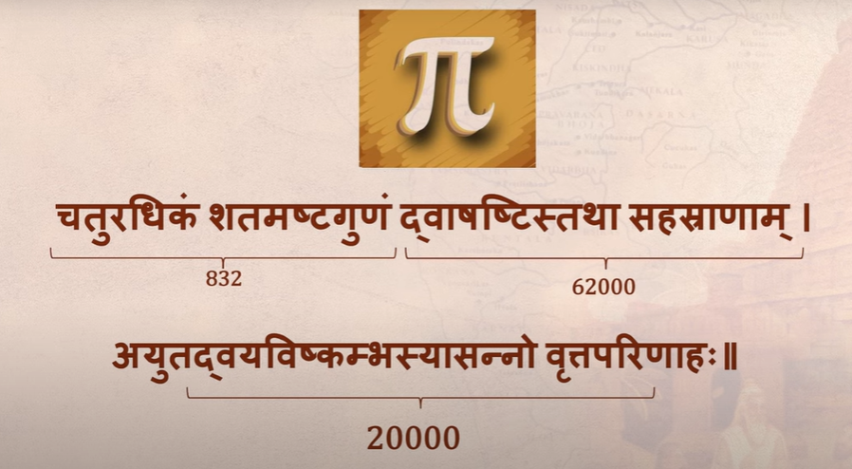
Invention of ∏:

Slide 24
Types of Vedic Literature
Vedic Literature
The Brahmanas
Shruti Literature
Smriti Literature
The Aranyakas
The Upanishads
The four Vedas i.e. the Rig, Sama, Yajur, and Atharva, and their Samhitas

Slide 25
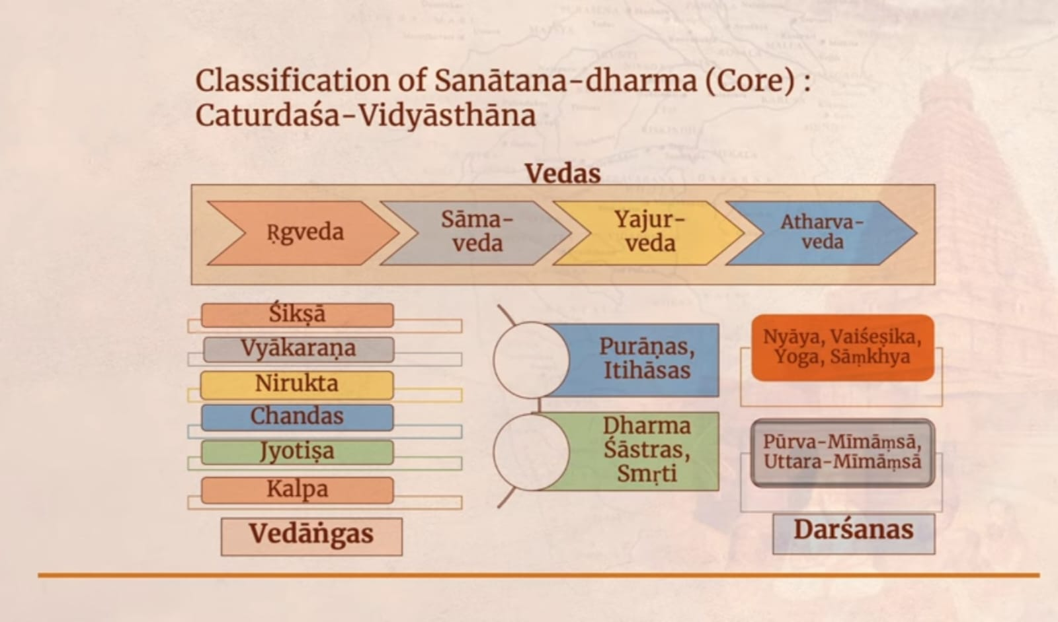

Slide 26
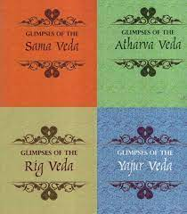
a)Rigveda:
It is the oldest form of Veda and oldest and biggest known Vedic Sanskrit text(1800 – 1100 BCE). The meaning of the word ‘Rigveda’ is Praise Knowledge. It has 1028 hymns called ‘Suktas’ and is a collection of 10 books called ‘Mandalas.’ The Rigveda, which was written as hymns to many Gods, is the oldest and most significant Veda. It is replete with information on the culture, rituals, cosmology, and philosophy of ancient India.

Slide 27
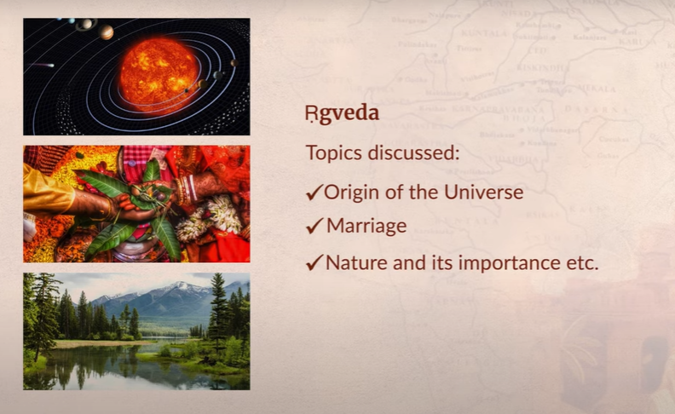
Topics discussed in Rigveda

Slide 28
b)Samaveda:
Known as the Veda of melodies and chants, Samaveda dates back to 1200-800 BCE. This Veda is related to public worship. The Samaveda is a compilation of chants and melodies derived from the Rigveda. It is primarily utilized by priests known as Samavedins during sacrifice ceremonies and concentrates on the musical parts of Vedic rituals. The Samaveda is considered as the root of the Indian classical music and dance. It is considered as the storehouse of the melodious chants.

Slide 29
c)Yajurveda:
Stands to mean ‘Worship Knowledge’, Yajurveda dates back to 1100-800 BCE; corresponding with Samaveda. It compiles ritual-offering mantras/chants. These chants were offered by the priest alongside a person who used to perform a ritual. The Yajurveda contains passages and directions for carrying out sacrifice ceremonies. The Krishna (Black) Yajurveda and the Shukla (White) Yajurveda are its two principal branches. Along with the lyrics, the Yajurveda has prose chapters that serve as instructions for priests performing ceremonies.

Slide 30
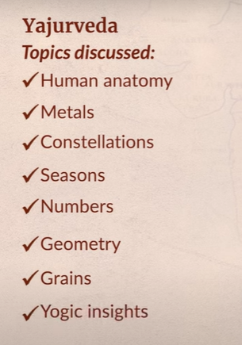
Topics discussed in Yajurveda

Slide 31
d)Atharvaveda:
Stands to mean a tatpurusha compound of Atharvan, an ancient sage, and knowledge (atharvan+knowledge), it dates back to 1000-800 BCE. The daily procedures of life are very well enumerated in this Veda. A collection of hymns and incantations known as the Atharvaveda. It includes a variety of content, such as prayers, spells, healing methods, and philosophical musings. In terms of presentation and topic matter, the Atharvaveda differs from the other Vedas.

Slide 32
Types of Vedas
Name of the Veda | Key Features of the Veda
Rig Veda | It is the earliest form of Veda
Samaveda | The earliest reference for singing
Yajurveda | It is also called the book of prayers
Atharvaveda | The book of magic and charms

Slide 33
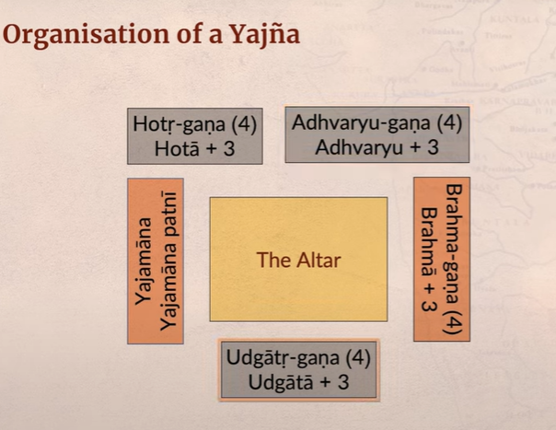
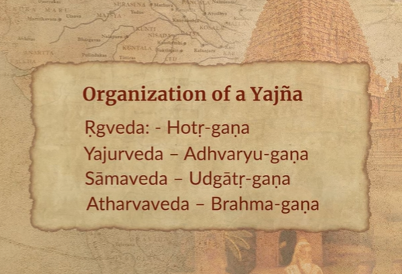
Project management in Ancient days

Slide 34
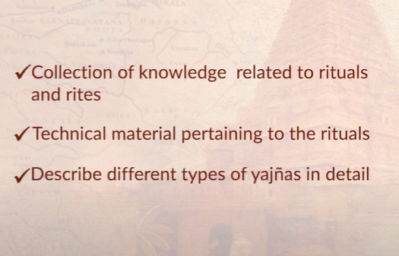
Vedic Literature – Brahamanas: It employs myths and stories to explain and advise Brahmins on how to perform Vedic rituals.
They are the prose texts that explain the hymns in the Vedas.
Each Veda has at least one Brahmana, and each Brahmana is typically connected to a specific Shakha or Vedic school.
Instruction manuals for performing sacrifices

Slide 35
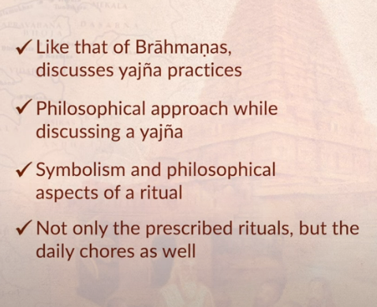
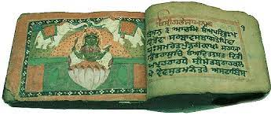
Vedic Literature – Aranyakas: A couple of significant facts about Aranyakas are that they write what are known as Forest Books and that they interpret sacrifice rites in a symbolic and philosophical manner.

Slide 36
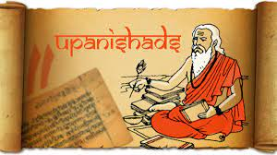
4)Vedic Literature – Upanishads:
It essentially means sitting near a guru and receiving the wisdom through a teaching-learning process
There are 108 Upanishads, which is one of their key characteristics. 13 of the 108 Upanishads are regarded as being the most important. Upanishads play a significant role in elucidating the ideas of "Atman" and "Brahman." It also includes philosophical thoughts on the following ideas: Expiation, Body, and Universe.
Notes:
Expiation- प्रायश्चित्त

Slide 37
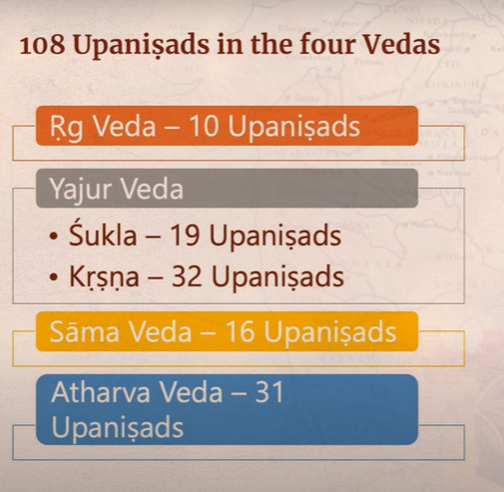

Slide 38
The Itihasas— Ramayana and Mahabharata
The Itihasas
Mahabharata
Ramayana

Slide 39
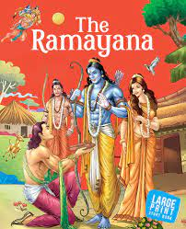
The Ramayana:
Ramayana literally translates to "the journey of Rama.“
https://www.youtube.com/watch?v=DejlW4Y0rIg

Slide 40
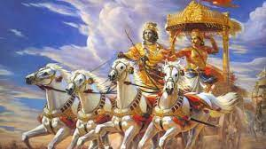
The Mahabharata
The Hastinapura Kingdom's struggle between two bands of brothers, which culminates in a huge battle, is essentially the subject of the Mahabharata.
https://www.youtube.com/watch?v=yh4OxzEFFzA

Slide 41
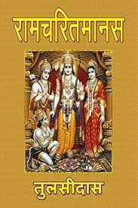
Importance in regional versions of Ramayana and Mahabharata
The Ramayana and Mahabharata have been repeated and changed in a variety of regional languages, giving rise to numerous variants that combine regional traditions, rituals, and interpretations
1)Ramcharitmanas: The Ramcharitmanas is a well-known Hindi translation of the Ramayana, and it was written by the saintly poet Tulsidas in the sixteenth century. It places a strong emphasis on devotion to Lord Rama and is written in the Awadhi dialect.
2)Kambaramayanam: The Kambaramayanam is a Tamil translation of the Ramayana, and it was written in the 12th century by the Tamil poet Kambar. It contains cultural and folkloric themes from the area.

Slide 42
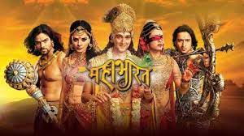
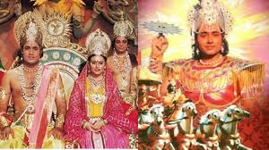
3)The Mahabharata has been retold in a number of regional Indian languages, including Bengali, Kannada, Telugu, and Malayalam, among others. Each variation includes the distinctive regional flavor and cultural quirks.

Slide 43
Let’s check the take away from this Lecture
Multiple Choice Questions (MCQ)
Bharatvarsha is derived from the _______ Bharata
Vedic
Sanskrit
Hindi
Marathi
Which of the following emperor has ruled over a vast territory of Bharatvarsha?
British
Mughals
Marathas
Bharata
Which of the following are included in land of rare natural endowments in Bharatvarsha?
Geographical features
Ecosystems
Flora, and fauna
All of the above

Slide 44
The Vedic literature consists of ____ Vedas
One
Two
Three
Four
Out of 108 Upanishads, ____ are considered the major ones
108
56
13
1
Mahabharata is based on ____
Pandavs
Kauravas
Krishna
All of the above

Slide 45
Lecture 02- The Puranas & Upanishads
The Puranas:
It is collection of myths, mythologies, genealogy, cosmologies, and stories about numerous Gods and heroes. There are 18 significant Puranas, which are classified into three groups:
Vishnu Puranas
Shiva Puranas
Brahma Puranas
It discusses the deity Vishnu and his avatars, such as the Vishnu Purana, Bhagavata Purana, and Narada Purana. They go into detail on creation stories, the ancestry of gods and sages, and the importance of devotion and moral behaviour.
These are texts that focus on the god Shiva, such as the Shiva Purana, Linga Purana, and Skanda Purana.
The creator deity Brahma's mythology and qualities are highlighted in the Brahma Puranas, which include the Brahma Purana, Brahmanda Purana, and Brahmavaivarta Purana. They also talk about things like cosmology, temples, holy places, and social practices.

Slide 46
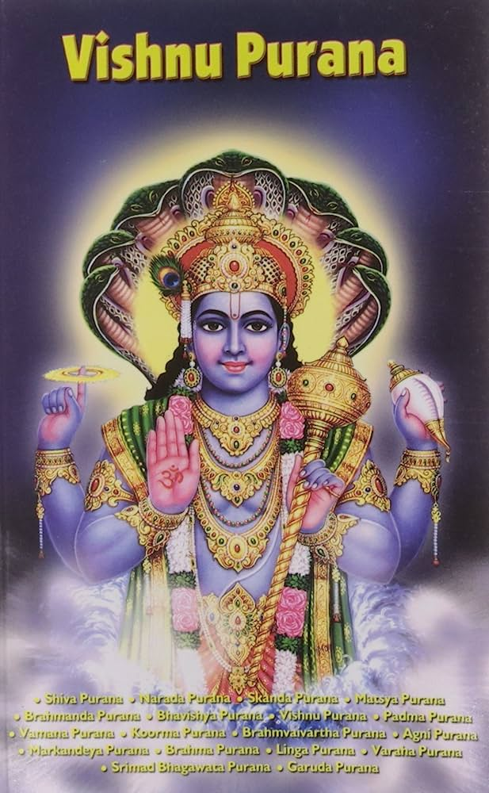
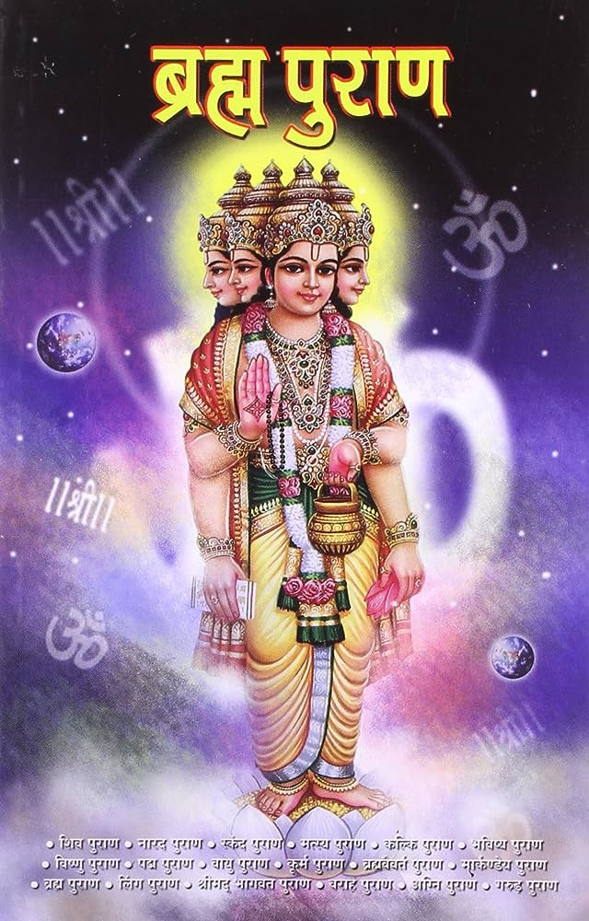

Slide 47
• Vishnu Puranas: These are texts that primarily discuss the deity Vishnu and his avatars, such as the Vishnu Purana, Bhagavata Purana, and Narada Purana. They go into detail on creation stories, the ancestry of gods and sages, and the importance of devotion and moral behavior.
• Shiva Puranas: These are texts that focus on the god Shiva, such as the Shiva Purana, Linga Purana, and Skanda Purana. They study deep into the mythology of Shiva, his many manifestations, ceremonies, and the significance of religious and spiritual practices including devotion and meditation.
• Brahma Puranas: The creator deity Brahma's mythology and qualities are highlighted in the Brahma Puranas, which include the Brahma Purana, Brahmanda Purana, and Brahmavaivarta Purana. They also talk about things like cosmology, temples, holy places, and social practices.

Slide 48
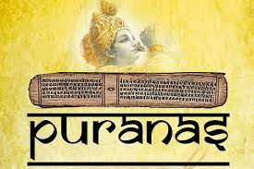
The Puranas serve a variety of functions, such as the preservation of historic tales and religious teachings, the exaltation of gods, and the advancement of moral and ethical principles. Hindus read them frequently and hold them in high regard for their spiritual and cultural value.
Notes:
Exaltation-उदात्तीकरण

Slide 49
Upanishads:
The Upanishads are a body of mystical and philosophical writings that are regarded as the pinnacle of Vedic wisdom.
They are frequently referred to as Vedanta, which is a Sanskrit term that means "the essence of the Vedas" or "the end of the Vedas."
In the Upanishads, sages and seekers converse on issues including the nature of reality (Brahman), one's identity (Atman), their connection to the collective unconscious, and the routes to self-realization and release (Moksha).
They explore ideas like karma, rebirth, meditation, and the character of ultimate truth.

Slide 50
The Brihadaranyaka Upanishad, Chandogya Upanishad, Katha Upanishad, and Taittiriya Upanishad are a few well-known Upanishads.
The Vedanta philosophy, which has greatly influenced Hindu thought and numerous schools of Indian philosophy, is founded on the Upanishads and the Bhagavad Gita (a portion of the Mahabharata).
The primary focus of the Upanishads is spiritual understanding. 200 Upanishads have reportedly been found. Each Upanishad establishes a connection to a Veda.

Slide 51
The most well-known Upanishad kinds include 13, including:
Chhandogya | Mandukya
Svetasvatara | Prasna
Mundaka | Kena
Maitri | Katha
Aitareya | Isa
Kaushitaki | Brihadaranyaka
Taittiriya

Slide 52
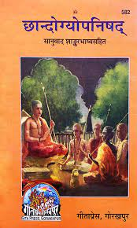
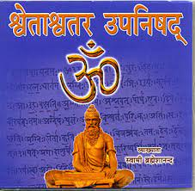
1)Chandogya Upanishad: The Sama Veda contains this Upanishad. The song's (saman-s) Chandoga vocalist is where the name originates. The others talk about yagnya (fire ritual), among other topics, as well as the history and profundity of the notion of Aum.
2)Svetasvatara Upanishad: The Svetasvatara Upanishad derives its name from the sage who taught it. This Upanishad teaches the unity of the souls and world in the one Supreme Reality. It is an attempt to reconcile the different philosophical and religious views, which prevailed at the time of its composition.
Notes:
Profundity-प्रगल्भता

Slide 53
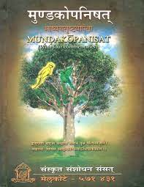
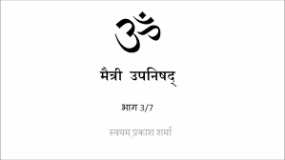
3)Mundaka Upanishad: This book is a part of the Atharva Veda as well. The name derives from the verb "mund," which means "to shave," suggesting that anyone who comprehends the Upanishads has been stripped of their ignorance. This book emphasizes how crucial it is to understand the supreme Brahmn since only through knowledge can one achieve self-realization.
4)Maitri Upanishad: This makes mention to the Hindu trinity of gods—Shiva, Vishnu, and Brahma—as well as the transient nature of the world.

Slide 54
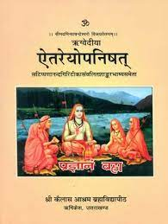
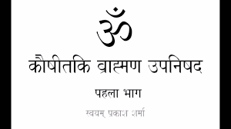
5)Aitareya Upanishad: This is a verse from the Rig Veda. The goal is to remove the reader from the superficial aspects of the actual act and help him realize the underlying significance of the yagnya (fire rite).
6)Kausitaki Brahmana Upanishad: This text's primary focus is on demonstrating how knowledge is the key to liberation.

Slide 55
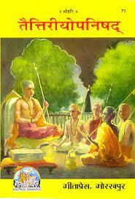
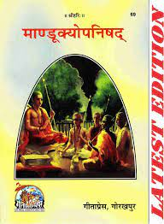
7)Taittriya Upanishad: This Upanishad, which is a segment of the Yajur Veda, is divided into three vallis. While Brahmananda valli and Bhrigu valli focus on self-realization, the shiksha valli addresses the phonetics of the chants.
8)Mandukya Upanishad: The Mandukya is a beautiful treatise that discusses the concept of Aum and its importance in many states of being, including waking, dreaming, and sleep without dreams. It is stated that this particular Upanishad—the subtlest and most profound of all of them—will take one directly to the path of enlightenment.

Slide 56
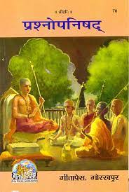
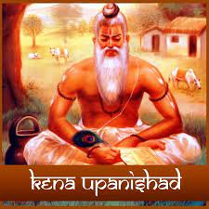
9)Prashna Upanishad: This Atharva Vedic text is titled Prashna, which is Sanskrit for "question." It answers queries about the ultimate cause, the strength of Aum, and the relationship between the supreme and the elements that make up the world.
10)Kena Upanishad:The name of this Upanishad comes from the first word kena, or by whom. It has 2 sections of prose and 2 of poetry. The verses deal with the supreme spirit or the absolute principle (Brahman) and the prose talks of Ishvara (God). The moral of the story is that the knowledge of Ishvara reveals the way to self-realization.

Slide 57


11)Katha Upanishad: This Upanishad, which is also known as the Kathakopanishad, uses a tale (katha) about a young Brahmana boy named Nachiketa and Yamaraja to illuminate the realities of this world and other realms.
12)Isha Upanishad: This text, also known as the Ishavasya Upanishad, discusses the confluence of God, the universe, being, and becoming. The Absolute's relationship to the world (Paramatma) is highlighted. The main message of the teachings is that one's worldly and heavenly objectives do not always have to conflict with one another.
Notes:
Confluence-संगम

Slide 58

13)Brhadaranyaka Upanishad: Most people agree that the Brhadaranyaka Upanishad is the most significant of all the Upanishads. It consists of three khandas. The link between the individual and the Universal self is something that the madhu khanda muses on. The argument known as the muni khanda of Yagnyavalkya provides the philosophical foundation for the prior instruction. The khila khanda discusses a variety of worship and meditation practices.

Slide 59
Difference between Vedas and Puranas
The difference between Vedas and Puranas are:
The Puranas are collections of religious legends, whereas the Vedas are the sacred text that has been passed down orally.
Vedas are Shruti scriptures, which translates to mean that they were written down based on what was "heard." Puranas, in contrast, are Smriti, which means "what is remembered."
Rig Veda, Sama Veda, Yajur Veda, and Atharva Veda are the four Vedas in all. There are 18 main Puranas, 18 minor Puranas, and one Mahapurana in total.

Slide 60
Let’s check the take away from this Lecture
Multiple Choice Questions (MCQ)
____ is a Sanskrit word that contains a mythological account of early times
Veda
Puran
Upnishad
Itihaas
Chandogya is a
Veda
Puran
Upnishad
Itihaas
The Purans are classified into ____ types
One
Two
Three
Four

Slide 61

Lecture 03- Earlier Buddhist writings

Slide 62
Lecture 03- Earlier Buddhist writings- Abhidhamma Pitaka,Vinaya Pitaka, Sutta Pitaka
The Tripitaka (three fold basket), often known as the Pali Canon, is a compilation of three books that contains the earliest Buddhist writings. In Theravada Buddhism, these compilations are regarded as the most reliable texts. The Tripitaka is divided into three sections:
Sutta Pitaka
Vinaya Pitaka
Abhidhamma Pitaka

Slide 64
1) Sutta Pitaka: The Buddha's teachings are presented in the Sutta Pitaka, commonly known as the "Basket of Discourses," which consists of talks, dialogues, and sermons. The remaining five Nikayas (collections) are as follows:
a. Digha Nikaya: The Digha Nikaya comprises long discourses where the Buddha expounds on various philosophical, ethical, and spiritual topics.
b. Majjhima Nikaya: The Majjhima Nikaya consists of medium-length discourses covering a wide range of subjects, including ethics, meditation, and the nature of reality.

Slide 65
c. Samyutta Nikaya: The Samyutta Nikaya contains grouped discourses categorized by themes, such as aggregates, sense bases, and dependent origination.
d. Anguttara Nikaya: The Anguttara Nikaya contains discourses arranged numerically, progressively expounding on lists of teachings and enumerations.
e. Khuddaka Nikaya: The Khuddaka Nikaya is a diverse collection of smaller texts, including the Dhammapada (a collection of verses), the Jataka tales (stories of the Buddha's past lives), and other important texts.

Slide 66
2)Vinaya Pitaka: The "Basket of Discipline," also known as the Vinaya Pitaka, contains norms and regulations for community life and monastic discipline. It discusses the processes for resolving conflicts and managing monastic affairs as well as the ethical and disciplinary norms expected of Buddhist monastics (bhikkhus and bhikkhunis).

Slide 67
3)Abhidhamma Pitaka: The "Basket of Higher Teachings," also known as the Abhidhamma Pitaka, offers a methodical and analytical explanation of Buddhist psychology, philosophy, and metaphysics. It explores intricate classifications, mental and mental-factor analysis, and the nature of reality.
It's crucial to remember that while Theravada Buddhism holds the Tripitaka in great esteem, other Buddhist schools have their own canons and scriptures. For instance, Mahayana Buddhism has a sizable collection of sutras of its own, including the Diamond Sutra, Lotus Sutra, and Heart Sutra.
The Tripitaka, which contains early Buddhist literature, is regarded as one of the best resources for learning about Buddhism's doctrines and origins. They form the basis for Buddhist ethics, meditation, philosophy, and the road to freedom.

Slide 68


Slide 69


Important Indian ancient Sanskrit literary work-Vikramovasiyam and Mricchakatika
Mricchakatika
Vikramovasiyam

Slide 70

1)Vikramorvasiya (The Love of Vikrama and Urvashi):
The legendary Sanskrit play The Vikramorvasiya was written by the legendary Indian poet Kalidasa. It is assumed that it was composed between the fourth and sixth centuries CE, under the Gupta Empire. The romance story of King Pururavas and celestial nymph Urvashi is told in the play.
The mortal monarch and the heavenly nymph fall in love and are later torn apart; this is the plot's central conflict. It looks with issues like love, desire, giving up oneself, and the struggle between the mortal and divine realms. The Vikramorvasiya is one of Kalidasa's most well-known compositions because of its lyrical and poetic language, vivid descriptions, and complex plot.

Slide 71

2)Mricchakatika (The Little Clay Cart):
A Sanskrit play called the Mricchakatika is credited to the legendary playwright Sudraka. It is regarded as one of the first complete Indian plays and is thought to have been composed during the Gupta era (4th–6th century CE).
Vasantasena, a courtesan, and Charudatta, a prosperous businessman, are major characters in the drama. It blends comedic, romantic, and political intrigue themes. The Mricchakatika, which depicts the lives of numerous individuals from various social origins, offers insights into the social and cultural environment of ancient India.
The play is famous for its description of human emotions, clever writing, and the representation of a variety of characters from various social classes. It emphasizes issues of justice, social hierarchy, morality, and love.

Slide 72
The Mricchakatika and the Vikramorvasiya are both important works of ancient Indian Sanskrit literature.
They offer perceptions into the culture, values, and creative sensitivities of that time period while showcasing the rich literary history of classical India.
Because of their literary greatness and cultural importance, these works are still studied, translated, and valued.

Slide 73
Multiple Choice Questions (MCQ)
Vikramovasiyam is written by
Visakhadatta
Kalidas
Kautilya
Sudraka
Mricchakatika is written by
Visakhadatta
Kalidas
Kautilya
Sudraka
Important Indian ancient Sanskrit literary work-Vikramovasiyam and Mricchakatika are written in ____ BC
5th
15th
25th
35th

Slide 74

Lecture 04- Sangam Literature

Slide 75
Lecture 04- Sangam Literature (Art & Culture)
The oldest Tamil literature that is still extant is known as “Sangam literature.“
'Sangam' roughly translates as ‘association’.
In this instance, it alludes to a group of Tamil poets who were active in ancient southern India.
Tradition has it that the first Tamil Sangam in Madurai was presided over by the Ancient Tamil Siddhar Agastyar. The Sangam Period encompasses this time frame.
The Cheras, the Cholas, and the Pandyas were the three principal Tamil kingdoms at this time.

Slide 76


Slide 77
Sangam Literature Classification
There were mainly three Sangams called Muchchangam. The chief sources of information for this age are archaeological sources, literary sources and foreign accounts.
Sangam Literature – Three Sangams
As mentioned before, Tamil legends talk about three Sangams:
Madurai
Kapadapuram
Madurai
Note: All the works of the first two Sangams except Tolkappiyam (2nd Sangam work) are lost. Only the works of the third Sangam survives.

Slide 78


Slide 79
Sangam Literature Classification
Based on Period of Composition | Details of Sangam Literature
Patinenmelkanakku | Works composed between 200 BCE to 100 BCE Oldest surviving Tamil poetry
Patinenkilkanakku | Works composed between 100 CE and 500 CE Collection of 18 poetry compositions Mostly composed before the age of the Pallavas Chief works include Thirukkural, Palamoli, Naladiyar, etc.
Based on the Context and Interpretation | Details of Sangam Literature
Aham (Inner) | Abstract discussion on human aspects such as love, relations, etc.
Puram (outer) | Human experiences such as heroism, customs, social life, ethics, philanthropy, etc.
Sangam Literature – Tolkappiyam- Composed by Tolkappiyar
Works on Tamil Grammer

Slide 80

Third Tamil Sangam
The compositions of the third Sangam are classified into eight anthologies known as Ettuttokoi/Ettuthokai and ten idylls known as Pattuppattu.
Ettuthokai
It consists of the following works:
Natrinai
Kuruntogai
Ainkurunuru (composed by Gudalur Mar)
Pathitrupathu
Paripadal
Kalittogai
Ahanuru (compiled by Rudrasarman)
Purananuru

Slide 81

Pattuppattu
It consists of the following works related to prose or verse:
ThiruMurugatrupadai (composed by Nakkirar)
Sirupanarruppadai
Perumbanarruppadai
Pattinappalai
Maduraikkanji
Porunararrupadai
Kurinchippattu
Nedunalvadai
Malaipadukadam
Mullaippattu

Slide 82


Slide 83

Patinenkilkanakku
Sangam & Thirukkural
First Dravidian work for ethics.
Comprises of 1330 couplets.
It has been translated into many languages including foreign languages.
It discusses epics, love, and polity and governance.
Authored by Thiruvalluvar.

Slide 84
Sangam & Silappadikaram
Composed by Ilango Adigal.
The story revolves around an anklet. The name literally means the tale of an anklet.
Author Ilango Adikal is supposed to be an ascetic-prince and the younger brother of Cheran king Senguttuvan.
A chief character is Kannagi, who seeks revenge on the Pandya kingdom for her husband who was wrongly put to death.
The poem gives a lot of insight into contemporary Tamil society, polity, values and social life of the people.

Slide 85



Slide 86



Slide 87


Slide 88

Sangam & Manimekalai
Composed by Chithalai Chathanar, also spelt Sattanar.
It is a sequel to Silappadikaram.
The author’s aim was to propagate Buddhism in South India as the work espouses the values of Buddhism over other religions of the time.

Slide 89


Slide 90
Let’s check the take away from this Lecture
Multiple Choice Questions (MCQ)
The compositions of the third Sangam are classified into eight anthologies known as
Ettuttokoi
Kapadapuram
Kautilya
Silappadikaram
Tamil legends Sangam talks about
Madurai
Visakhadatta
Kalidas
Kautilya
How many works of Sangam literature are lost?
One
Two
Three
Four

Slide 91
Thank You

